Slide 1
Unordered List
Chapter 2

Slide 2
Introduction
Is a linear collection of entries in which entries may be added, removed, and searched for without restrictions.
Unordered list main operations:
  Add: add new entry to the end of the list.
  Remove: remove specific element from unordered list.
  Search(Sequential Search): Since the list is unordered, the only way to conduct the search is to look at every element in the sequence. If a match is found, the operation returns true, otherwise it returns false.

Slide 3
Keeping Track of Daily Expenses Problem
It would be useful to write a program that maintains an expense list of all recorded expenses, that can be used to find quick answers to simple budgeting type questions.
  What is the average expense?
  What is the total amount spent?
  Print out all expenses.
So, which data structure should we use to store the expenses and answer the above questions and more?

Slide 4
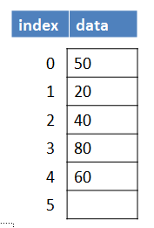
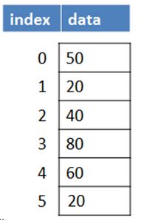

Unordered List Operations
Add: add new entry to the end of the list.
Example: add 20 to the following unordered list:

Slide 5
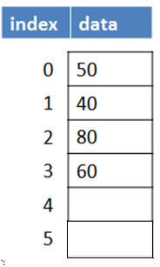
Unordered List Operations
Remove: remove specific element from unordered list.
Example: remove 20 from the following unordered list:

Slide 6
Unordered List Operations
Search(Sequential Search): Since the list is unordered, the only way to conduct the search is to look at every element in the sequence. If a match is found, the operation returns true, otherwise it returns false.

Slide 7
Using ArrayList Class to Implement Unordered List Data Structure
ArrayList in Java is used to store dynamically sized collection of elements.
Contrary to Arrays that are fixed in size, an ArrayList grows its size automatically when new elements are added to it.
Java ArrayList allows duplicate and null values.
You cannot create an ArrayList of primitive types like int, char etc. You need to use boxed types like Integer, Character, Boolean etc.

Slide 8
ArrayList Constructor
Constructor and Description
ArrayList() Constructs an empty list with an initial capacity of ten.
ArrayList(Collection c) Constructs a list containing the elements of the specified collection, in the order they are returned by the collection's iterator.
ArrayList(int initialCapacity) Constructs an empty list with the specified initial capacity.

Slide 9
ArrayList Methods
boolean | add(E e) Appends the specified element to the end of this list.
void | add(int index, E element) Inserts the specified element at the specified position in this list.
boolean | addAll(Collection c) Appends all of the elements in the specified collection to the end of this list, in the order that they are returned by the specified collection's Iterator.
boolean | addAll(int index, Collection c) Inserts all of the elements in the specified collection into this list, starting at the specified position.

Slide 10
ArrayList Methods
void | clear() Removes all of the elements from this list.
Object | clone() Returns a shallow copy of this ArrayList instance.
boolean | contains(Object o) Returns true if this list contains the specified element.
E | get(int index) Returns the element at the specified position in this list.
int | indexOf(Object o) Returns the index of the first occurrence of the specified element in this list, or -1 if this list does not contain the element.

Slide 11
ArrayList Methods
boolean | isEmpty() Returns true if this list contains no elements.
int | lastIndexOf(Object o) Returns the index of the last occurrence of the specified element in this list, or -1 if this list does not contain the element.
E | remove(int index) Removes the element at the specified position in this list.
boolean | remove(Object o) Removes the first occurrence of the specified element from this list, if it is present.
boolean | removeAll(Collection c) Removes from this list all of its elements that are contained in the specified collection.

Slide 12
ArrayList Methods
protected void | removeRange(int fromIndex, int toIndex) Removes from this list all of the elements whose index is between fromIndex, inclusive, and toIndex, exclusive.
E | set(int index, E element) Replaces the element at the specified position in this list with the specified element.
int | size() Returns the number of elements in this list.
List<E> | subList(int fromIndex, int toIndex) Returns a view of the portion of this list between the specified fromIndex, inclusive, and toIndex, exclusive.
Object[] | toArray() Returns an array containing all of the elements in this list in proper sequence (from first to last element).

Slide 13
Example 1
public static void main(String[] args) {
  ArrayList <String> animals = new ArrayList<>(); animals.add("Lion");
  animals.add("Tiger");
  animals.add("Cat");
  animals.add("Dog");
  System.out.println(animals);
  animals.add(2, "Elephant");
  System.out.println(animals);
}
# Output
[Lion, Tiger, Cat, Dog]
[Lion, Tiger, Elephant, Cat, Dog]

Slide 14
Exercise 1
Find the output for the following code:
public static void main(String[] args) {
  ArrayList <String> a1= new ArrayList<>();
  a1.add(“AA");
  a1.add(“SS");
  a1.add(“TT");
  a1.add(“WW");
  System.out.println(a1);
  a1.add(2, “HH");
  System.out.println(a1);
}

Slide 15
Example 2
public static void main(String[] args) {
  ArrayList <Integer> PN1 = new ArrayList<>();
  PN1.add(2);
  PN1.add(3);
  PN1.add(5);
  PN1.add(7);
  PN1.add(11);
  ArrayList <Integer> PN2= new ArrayList<>(PN1);
  ArrayList <Integer> PN3= new ArrayList<>();
  PN3.add(13);
  PN3.add(17);
  PN3.add(19);
  PN3.add(23);
  PN3.add(29);
  PN2.addAll(PN3);
  System.out.println(PN2);
}
# Output
[2, 3, 5, 7, 11, 13, 17, 19, 23, 29]

Slide 16
Exercise 2
Find the output for the following code:
public static void main(String[] args) {
  ArrayList <Integer> nums1= new ArrayList<>();
  nums1.add(20);
  nums1.add(30);
  nums1.add(50);
  nums1.add(70);
  nums1.add(101);
  ArrayList <Integer> nums2= new ArrayList<>(nums1);
  ArrayList <Integer> nums3= new ArrayList<>();
  nums3.add(130);
  nums3.add(170);
  nums3.add(190);
  nums3.add(230);
  nums3 add(290);
  nums2.addAll(nums3);
  System.out.println(nums2);
}

Slide 17
Example 3
public static void main(String[] args) {
  ArrayList <String> top = new ArrayList<>();
  System.out.println("Is the top list empty? : " + top.isEmpty());
  top.add("Google");
  top.add("Apple");
  top.add("Microsoft");
  top.add("Amazon");
  top.add("Facebook");
  System.out.println(“The top " + top.size() + " companies in the world");
  System.out.println(top);
  String bestCompany = top.get(0);
  String secondBestCompany = top.get(1);
  String lastCompany = top.get(top.size() - 1);
  System.out.println("Best Company: " + bestCompany); System.out.println("Second Best Company: " + secondBestCompany); System.out.println("Last Company in the list: " + lastCompany);
  top.set(4, "Walmart");
  System.out.println("Modified top companies list: " + top); }

Slide 18
Example 3 Output
Is the top list empty? : true
The top 5 companies in the world
[Google, Apple, Microsoft, Amazon, Facebook]
Best Company: Google
Second Best Company: Apple
Last Company in the list: Facebook
Modified top companies list: [Google, Apple, Microsoft, Amazon, Walmart]

Slide 19
Exercise 3
Find the output for the following code:
public static void main(String[] args) {
  ArrayList <String> t1 = new ArrayList<>();
  System.out.println(t1.isEmpty());
  t1.add(“AA");
  t1.add(“WW");
  t1.add(“TT");
  t1.add(“FF");
  t1.add(“HH");
  System.out.println(t1.size());
  System.out.println(t1);
  String b = t1.get(0);
  String s = t1.get(1);
  String l = t1.get(t1.size() - 1);
  System.out.println(b);
  System.out.println(s);
  System.out.println(l);
  t1 set(4, “GG");
  System.out.println(t1); }

Slide 20
Example 4 part 1
public static void main(String[] args) {
ArrayList <String> programmingLanguages = new ArrayList<>(); programmingLanguages.add("C");
programmingLanguages.add("C++");
programmingLanguages.add("Java");
programmingLanguages.add("Kotlin");
programmingLanguages.add("Python");
programmingLanguages.add("Perl");
programmingLanguages.add("Ruby");
System.out.println("Initial List: " + programmingLanguages); programmingLanguages.remove(5);
System.out.println("After remove(5): " + programmingLanguages);

Slide 21
Example 4 part 2
boolean isRemoved = programmingLanguages.remove("Kotlin");
System.out.println("After remove(Kotlin): " + programmingLanguages
ArrayList <String> scriptingLanguages = new ArrayList<>(); scriptingLanguages.add("Python");
scriptingLanguages.add("Ruby");
scriptingLanguages.add("Perl"); programmingLanguages.removeAll(scriptingLanguages);
System.out.println("After removeAll(scriptingLanguages):“ +programmingLanguages);
programmingLanguages.clear();
System.out.println("After clear(): " + programmingLanguages); }

Slide 22
Example 4 Output
Initial List: [C, C++, Java, Kotlin, Python, Perl, Ruby]
After remove(5): [C, C++, Java, Kotlin, Python, Ruby]
After remove("Kotlin"): [C, C++, Java, Python, Ruby]
After removeAll(scriptingLanguages): [C, C++, Java]
After clear(): []

Slide 23
Exercise 4
Find the output for the following code:
public static void main(String[] args) {
ArrayList <String> p1 = new ArrayList<>();
p1.add(“AA");
p1.add(“HH");
p1.add(“JJ");
p1.add(“KK");
p1.add(“YY");
p1.add(“PP");
p1.add(“RR");
System.out.println( p1);
p1.remove(5);
System.out.println(p1);

Slide 24
boolean isRemoved = p1.remove(“KK");
System.out.println(p1)
ArrayList <String> s1 = new ArrayList<>();
s1.add(“YY");
s1.add(“RR");
s1.add(“PP");
p1.removeAll(s1);
System.out.println(p1);
p1.clear();
System.out.println(p1); }

Slide 25
Example 5
  public static void main(String[] args) {
  ArrayList<String> cars = new ArrayList<String>();
  cars.add("Volvo");
  cars.add("BMW");
  cars.add("Ford");
  cars.add("Mazda");
  for (String x : cars) {
  System.out.println(x);
  }
}
#Output
Volvo
BMW
Ford
Mazda

Slide 26
Exercise 5
Find the output for the following code:
  public static void main(String[] args) {
  ArrayList<String> c1 = new ArrayList<String>();
  c1.add(“VV");
  c1.add(“BB");
  c1.add(“FF");
  c1.add(“MM");
  for (String item : c1) {
  System.out.println(item);
  }
}

Slide 27
Example 6
  public static void main(String[] args) {
  ArrayList<String> cars = new ArrayList<String>();
  cars.add("Volvo");
  cars.add("BMW");
  cars.add("Ford");
  cars.add("Mazda");
  Collections.sort(cars);
  for (String x : cars) {
  System.out.println(x);
  }
}
#Output
BMW
Ford
Mazda
Volvo

Slide 28
Exercise 6
Find the output for the following code:
  public static void main(String[] args) {
  ArrayList<String> c1 = new ArrayList<String>();
  c1.add(“VV");
  c1.add(“BB");
  c1.add(“FF");
  c1.add(“MM");
  Collections.sort(c1);
  for (String item : c1) {
  System.out.println(item);
  }
}

Slide 29
Example 7
  public static void main(String[] args) {
  ArrayList<String> cars = new ArrayList<String>();
  cars.add("Volvo");
  cars.add("BMW");
  cars.add("Ford");
  cars.add("Mazda");
  for (int i=0;i<cars.size();i++) {
  System.out.println(cars.get(i));
  } `
}
#Output
Volvo
BMW
Ford
Mazda

Slide 30
Example 8
public static void main(String[] args) {
List<String> names = new ArrayList<>();
names.add("John");
names.add("Alice");
names.add("Bob");
names.add("Steve");
names.add("John");
names.add("Steve");
names.add("Maria");
System.out.println("Does Bob exist? : "+names.contains("Bob"));
System.out.println("indexOf Steve: " + names.indexOf("Steve")); System.out.println("indexOf Mark: " + names.indexOf("Mark"));
System.out.println("lastIndexOf Steve : "+names.lastIndexOf(" Steve ")); }

Slide 31
Example 8 Output
# Output
Does Bob exist? : true
indexOf "Steve": 3
indexOf "Mark": -1
lastIndexOf " Steve " : 5

Slide 32
Example 9 part 1
class User {
  public String name;
  public int age;
  public User(String name, int age) {
    this.name = name;
    this.age = age;
    }
  }

Slide 33
Example 9 part 2
public static void main(String[] args) {
  ArrayList <User> users = new ArrayList<>(); users.add(new User("Rajeev", 25));
  users.add(new User("John", 34));
  users.add(new User("Steve", 29));
  for(User user : users ) {
  System.out.println("Name : "+user.name+", Age : "+ user.age);
  }
  }

Slide 34
Example 9 Output
# Output
  Name : Rajeev, Age : 25
  Name : John, Age : 34
  Name : Steve, Age : 29

Slide 35
Code for Keeping Track of Daily Expense Problem

Slide 36
Adding new price by user
import java.util.Scanner;
import java.util. ArrayList;
public static void main(String[] args) {
ArrayList<Float> expenses = new ArrayList<Float>();
Scanner s = new Scanner(System.in);
System.out.println("Enter price");
num = s.nextFloat();
expenses.add(num);

Slide 37
Deleting price entered by user
System.out.println("Enter price");
num = s.nextFloat();
expenses.remove(num);

Slide 38
Search for an price entered by user
System.out.println("Enter price");
num = s.nextFloat();
if(expenses.contains(num))
System.out.println("price found");
else
System.out.println("price not found");

Slide 39
Finding Minimum Price
Float min = expenses.get(0);
for(int i=1;i<expenses.size();i++)
{
if(min>expenses.get(i))
min=expenses.get(i);
}
System.out.println("minimum price is: "+min);

Slide 40
Finding the total
Float sum=0f;
for(int i=0;i<expenses.size();i++)
{
sum+=expenses.get(i);
}
System.out.println("Total price is: "+sum);

Slide 41
Print All Prices
System.out.println("All prices are: "+expenses);

Slide 42
The Complete program

Slide 43
package expensbyaeeaylist;
import java.util.*;
public class ExpensByAeeayList {
public static void main(String[] args) {
ArrayList<Float> expenses = new ArrayList<Float>();
Scanner s = new Scanner(System.in);
Float num;
Float min;
Float sum=0f;
int choice;
boolean run = true;
while(run)
{
System.out.println("***********************************");
System.out.println("***********************************");
System.out.println("To insert new price press 1.");
System.out.println("To delete a price press 2.");
System.out.println("To search for a price press 3.");
System.out.println("To find minimum price press 4.");
System.out.println("To find total price press 5.");
System.out.println("To print all prices press 6.");
System.out.println("To exit press 7.");
System.out.println("***********************************");
System.out.println("***********************************");
choice = s.nextInt();

Slide 44
switch(choice)
{
case 1:
System.out.println("Enter price");
num = s.nextFloat();
expenses.add(num);
break;
case 2:
System.out.println("Enter price");
num = s.nextFloat();
expenses.remove(num);
break;
case 3:
System.out.println("Enter price");
num = s.nextFloat();
if(expenses.contains(num))
System.out.println("price found");
else
System.out.println("price not found");
break;
case 4:
min = expenses.get(0);
for(int i=1;i<expenses.size();i++)
{
if(min>expenses.get(i))
min=expenses.get(i);
}
System.out.println("minimum price is: "+min);
break;

Slide 45
case 5:
for(int i=0;i<expenses.size();i++)
{
sum+=expenses.get(i);
}
System.out.println("Total price is: "+sum);
break;
case 6:
System.out.println("All prices are: "+expenses);
break;
case 7:
run = false;
break;
default:
System.out.println("not valid choise, press number from 1 to 7");
break;
}
}
}
}

Slide 46
Improving Our Solution
Use a class to implement Expense list which has ArratList object and methods that implement the operation needed in Keeping track of daily expense problem.
Instead of store only the prices in ArrayList, we can create class that implement each item [price, name …] then store object of this class in the ArrayList
2) Add new methods to enhance the class

Slide 47
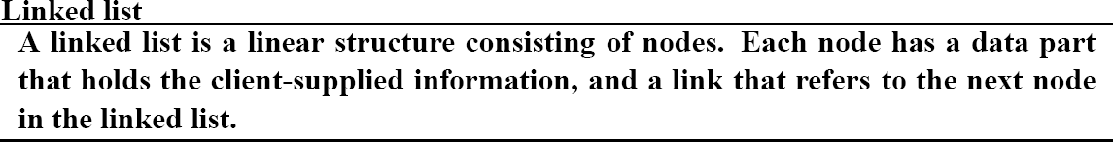
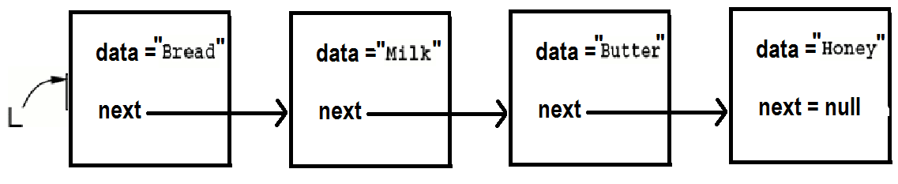

Linked List
L.data = “Bread”, L.next.data = “Milk”, L.next.next.data=“Butter”

Slide 48
Linked List
To access the entries of the linked list, a reference to its first entry is all we need.
  One can access any entry by simply following the chain of links.
  When an entry is removed from some place in a linked list, all that needs to be done is to have its predecessor's link refer to its successor.
  Similarly, an entry may be inserted anywhere in the list without having to move other entries over to create space.

Slide 49
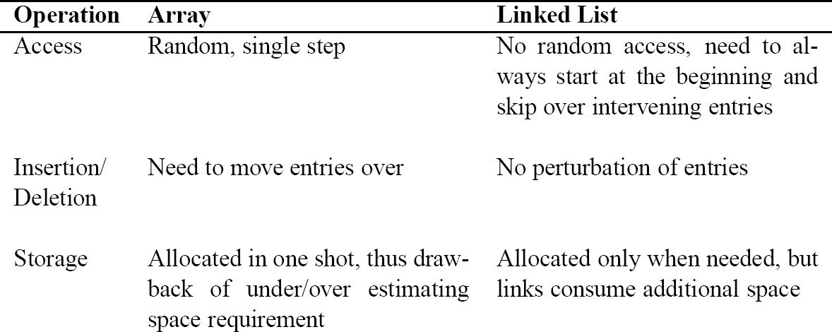
Linked List vs. Array

Slide 50
Linked List Drawback
The biggest drawback of the linked list is its inability to perform random accesses for any entry in a single step.

Slide 51
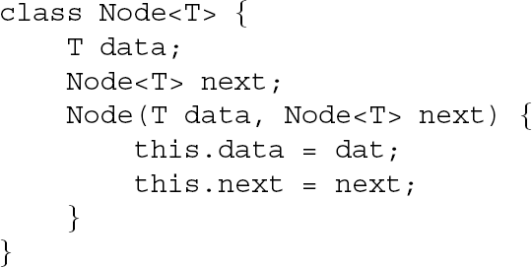
Node
A node is defined in terms of itself:
  next field of the node class is a reference to another Node<T> object.
  Self-referential structure.

Slide 52
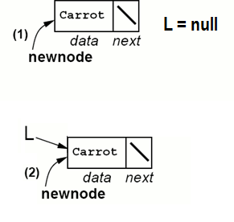

Insertion a new node to Linked List
Adding new node to empty Linked List L.
  ➔L=null

Slide 53
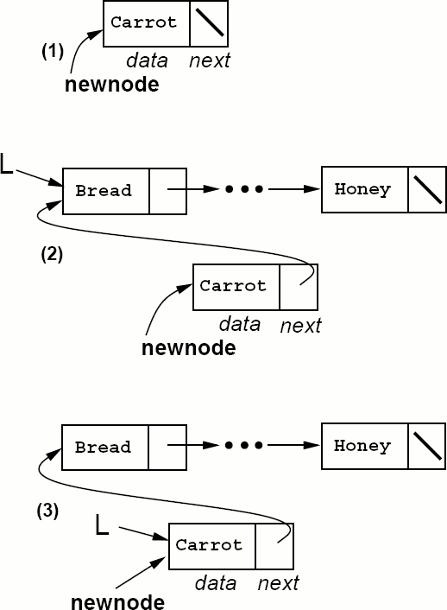
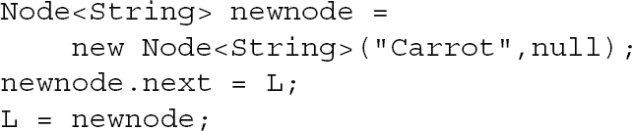
Insertion a new node to Linked List
Adding new node to the beginning of the list.

Slide 54
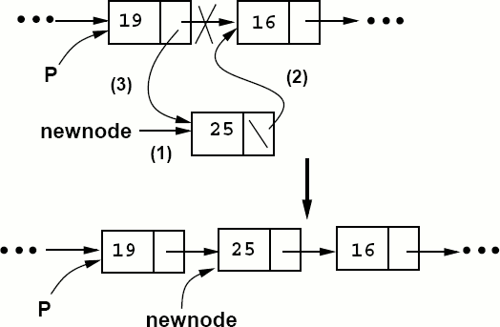

Insertion a new node to Linked List
Adding new node in between two nodes.

Slide 55
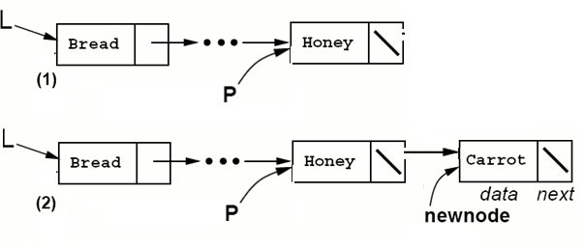

Insertion a new node to Linked List
Adding new node to the end of the list.

Slide 56
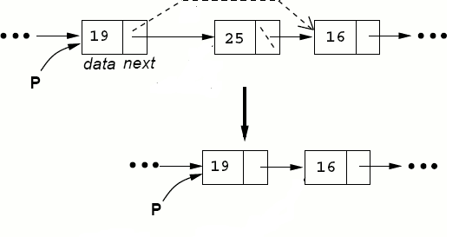

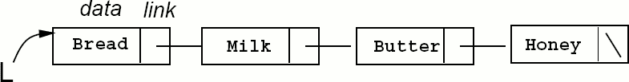
4.5.3 Deletion
Deleting the last node, or in-between node.
Deleting the first node
  L = L.next

Slide 57
4.5.3 Deletion
In both insertion and deletion we assumed the existence of P, a reference to the node just prior to the one to be inserted or deleted.

Slide 58
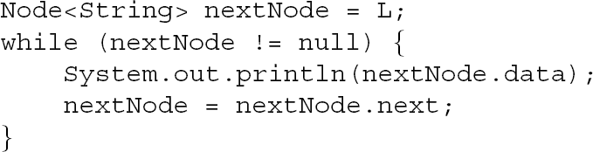
4.5.4 Access
Stepping through, or traversing, all the entries of a linked list from beginning to end following the chain of references is a useful operation in practice.

Slide 59
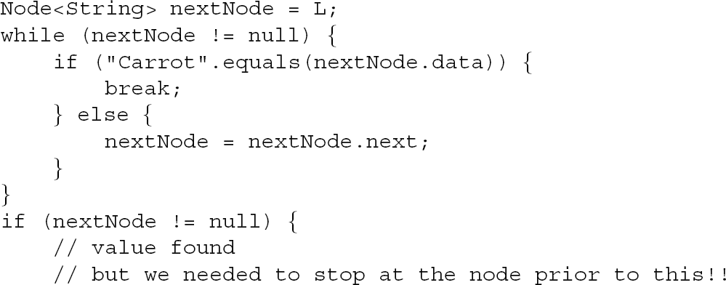
4.5.4 Access

Slide 60
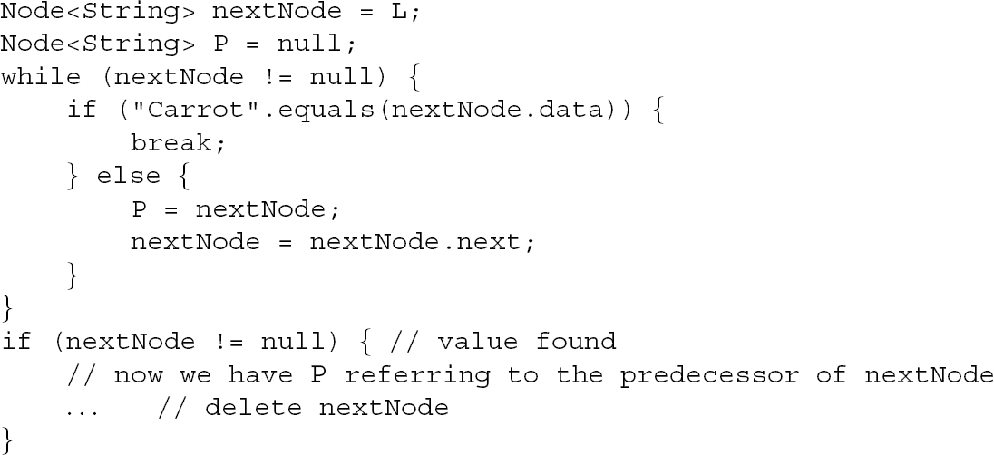
4.5.4 Access
Deleting the first occurrence of the string “Carrot”.
We can't delete nextNode unless we have a reference to the node prior to it.

Slide 61
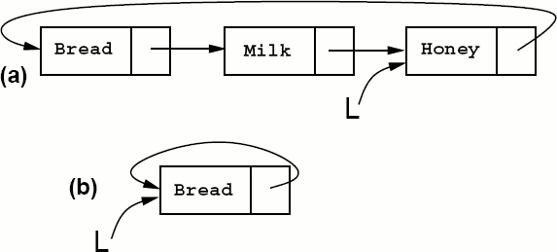
4.5.5 Circular Linked List
It is useful to have instant access to both the first and the last entries of a linked list.

Slide 62
4.5.5 Circular Linked List
Given that L refers to the last entry, the first entry is simply L.next.
  if L==L.next, that means there is exactly one entry in the CLL.

Slide 63
Doubly Linked List
A linked list in which each node is linked to both its successor and its predecessor

Slide 64
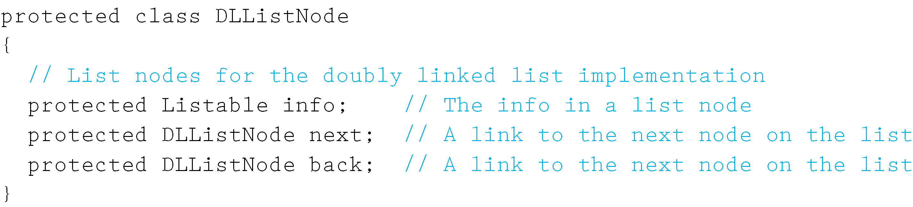

Slide 65
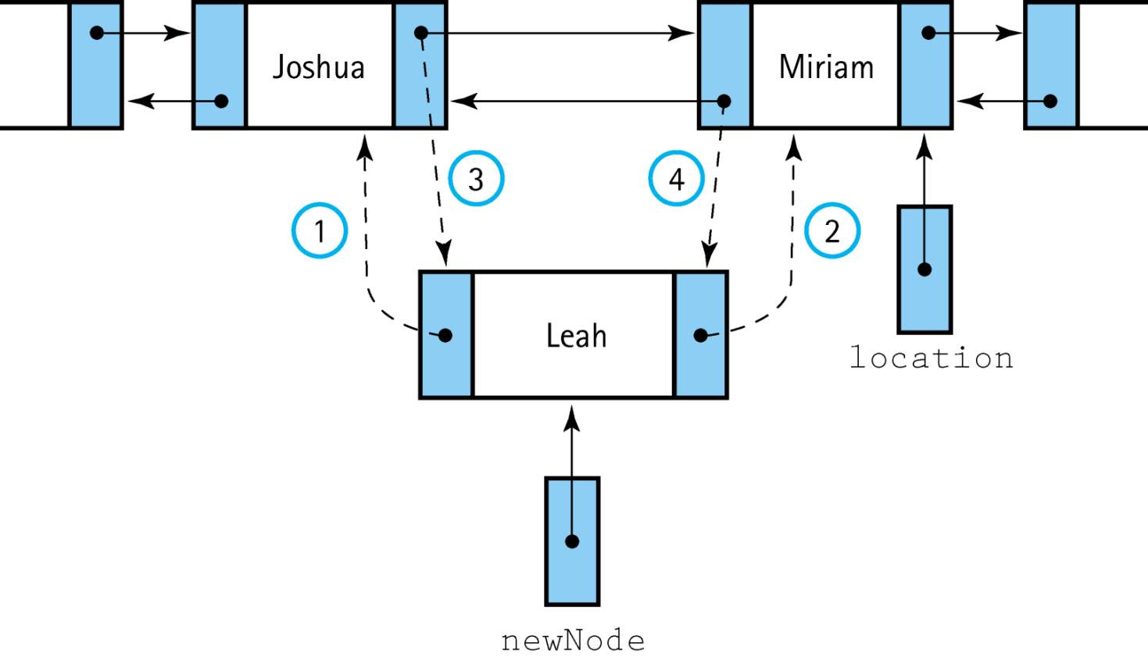
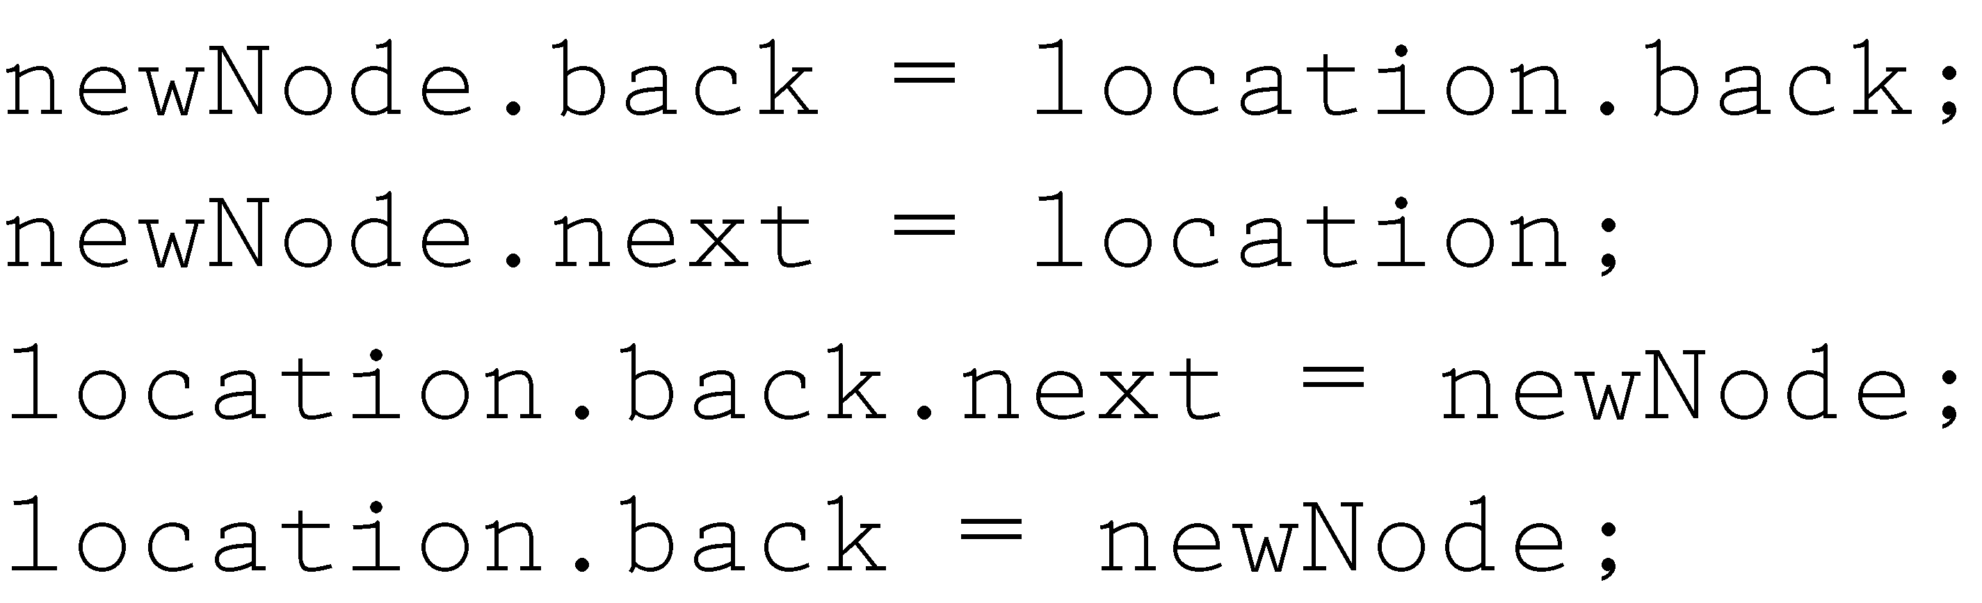
Inserting into a Doubly Linked List

Slide 66
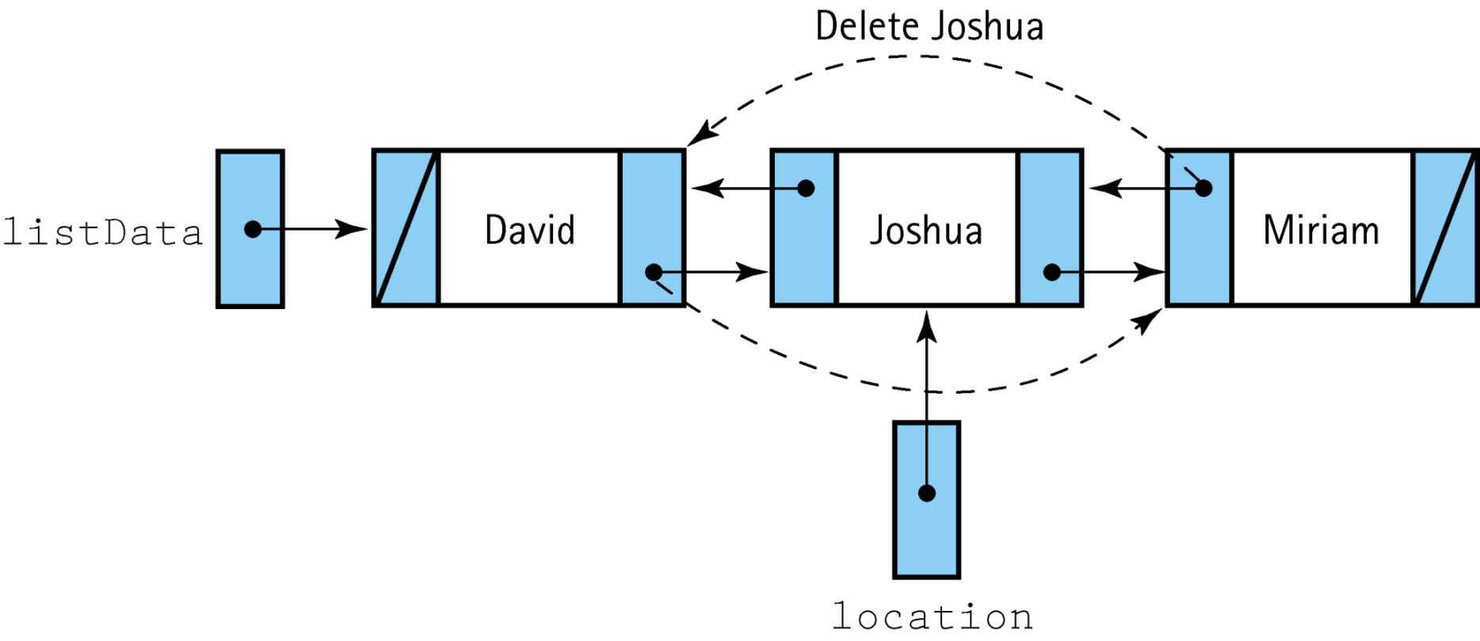
Deleting from a Doubly Linked List

Slide 67
References
https://www.callicoder.com/java-arraylist/
https://www.w3schools.com/java/java_arraylist.asp
https://docs.oracle.com/javase/8/docs/api/java/util/ArrayList.html#isEmpty--

